Slide 1
Lego Robotics
Training Engineers from grades K through 6

Slide 2
The Robots

Slide 3
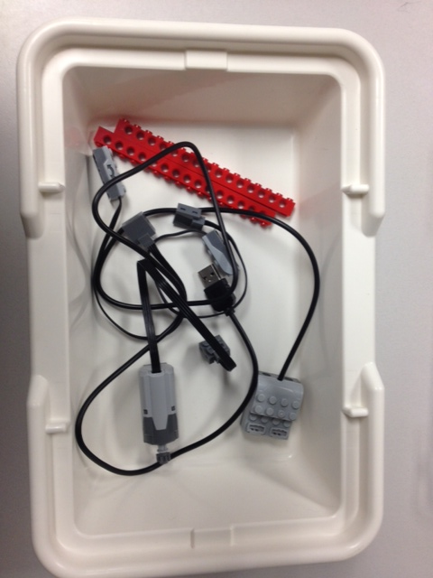
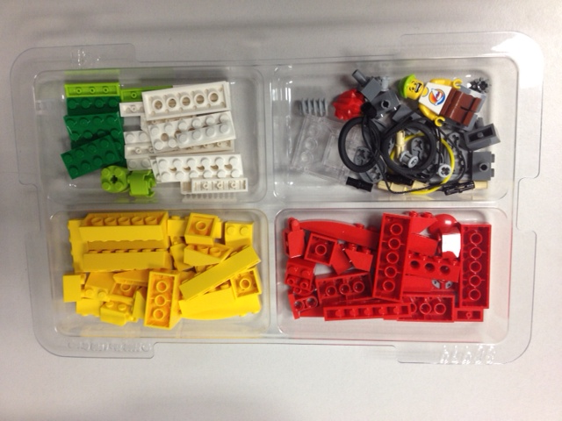
Lego Wedo®

Slide 4
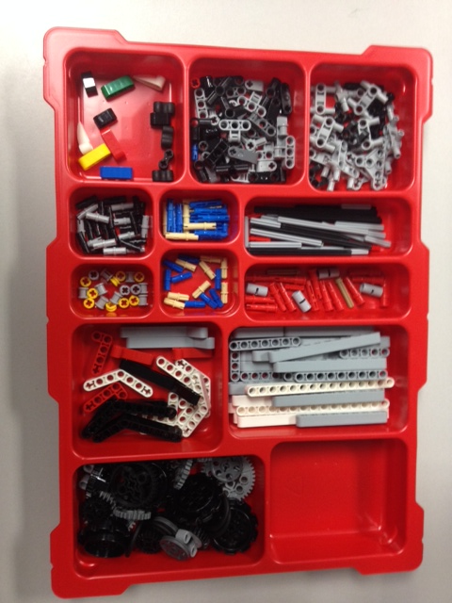
Lego Mindstorms® EV3

Slide 5
Projects and Objectives

Slide 6
Wedo Objectives
Help younger students (K-3) understand basic programming techniques and capabilities of the robots
Builds skills they can apply to EV3 robots down the road
Develop understanding of how the robots work and how they are able to function autonomously

Slide 7
Programming the Wedo Robots
Software program comes with the kits, can be installed on as many devices as desired
Drag and drop interface
Different “blocks” serve different purposes (movement, duration, sensors, etc)

Slide 8
Programming EV3 Mindstorms
Online download connected to your Lego Education account
Drag and drop interface similar to Wedo software
Different blocks serve different purposes
Many more features, capabilities, and settings than Wedo

Slide 9
Student Projects
Drive Straight
Drive Straight and stop on its own
Stop on a line using light/color sensor
Robot Sumo Wrestling (push opponent out of circle, use ultrasonic sensor to find opponent, light sensor keep your robot from driving out)

Slide 10
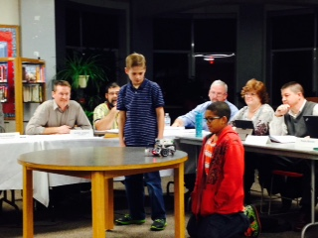
Students At Work

Slide 11
Establishing a Robotics Curriculum

Slide 12
Associated Costs
Wedo kits: $75/kit
EV3 Mindstorms: $350/kit
Cost of laptops or tablets
Instructor
Other materials: electrical tape, white boards, wood, etc.

Slide 13
Funding
Innovation School Grants: materials and devices purchased with grant money
Use laptops already at the school
Instructor: Computer/IT position within regular budget; afterschool program funded with grant

Slide 14
Schedule
Afterschool:
Two 1-hour sessions
1st session K-3 2nd session 4-6
Regular School Day:
Each homeroom gets one ½ hour period per week
Time comes from science (robotics and engineering account for 25% of new frameworks)
Homeroom teacher stays with class

Slide 15
What’s Next?
Expand time spent on robotics/engineering
Eliminate library; combine computer lab and library to media class and spend extra time on engineering
Goal: at least 45 minutes per class per week
Have one position be focused solely on STEAM

